Slide 1

2018 SAVE MEDICARE & MEDICAID
The New Tax Law & its Affects on Seniors

Slide 2
State of Play
Review: 2017 Tax Bill
After a long-fought battle, on Wednesday, December 20th, the Senate passed a tax bill through budget reconciliation.
On Friday, December 22nd, Trump signed the tax bill into law.
Months earlier, the AFL-CIO set Tax Reform Principles by which to measure any tax reform.
Notes:
President Trump claims that the U.S. corporate rate it is highest in the world. However, in 1952, corporate profits were 5.5 percent of the economy, and corporate taxes were 5.9 percent. Today, corporate profits are 8.5 percent of the economy, and corporate taxes are just 1.9 percent of GDP. Corporations used to contribute $1 out of every $3 in federal revenue. Today, despite very high corporate profitability, it is $1 out of every $9.
Also, the effective tax rate (the amount they actually pay) is around 14%
And in 2010, large, profitable corporations paid only 12.6 percent, and 26 corporations – GE, Boeing, Verizon, Priceline – (those on the screen) paid no federal taxes over 5 years.
Yet despite this reality, President Trump proposes reward corporations by reducing by more than half (60%) from 35% to 15%.

Slide 3
State of Play
Review: AFL-CIO Tax Reform Principles
Big corporations and the wealthy must pay their share of taxes.
Tax reform must raise significantly more revenue.
Tax reform must eliminate the incentive for corporations to shift jobs and profits offshore.
Global corporations must pay what they owe on past profits held offshore.
Notes:
BIG CORPORATIONS AND THE WEALTHY MUST PAY THEIR FAIR SHARE OF TAXES.
• Our rigged and broken tax system lets big corporations and the wealthy avoid paying their fair share of taxes, sticking the rest of us with the tab.
• Tax reform must not cut taxes for big corporations or the wealthy.
• On the contrary, tax reform should restore taxes on the wealthiest estates and tax the income of investors as much as the income of working people.
• Tax reform must make our tax system more progressive than it is now.
• Big corporations and the wealthy must pay more in taxes than they pay now, so we can build an economy that works for all of us.
2.TAX REFORM MUST RAISE SIGNIFICANTLY MORE REVENUE.
• Tax reform must raise enough additional revenue over the long term to create good jobs and make the public investment we need in education, infrastructure, and meeting the needs of children, families, seniors and communities.
• Any tax reform that reduces revenues in the short term or the long term is unacceptable.
• Cost estimates must be honest and not rely on gimmicks that hide the true long-term cost of tax cuts.
3.TAX REFORM MUST ELIMINATE THE TAX INCENTIVE FOR CORPORATIONS TO SHIFT JOBS AND PROFITS OFFSHORE.
• Taxing offshore profits less than domestic profits creates an incentive for corporations to shift jobs and profits offshore, while giving global corporations a competitive advantage over domestic corporations.
• Tax reform must eliminate the tax incentive for corporations to shift jobs and profits offshore, which would raise nearly $1 trillion over 10 years.
• A “territorial” system that further reduces taxes on offshore profits would increase the tax incentive for global corporations to shift jobs and profits offshore.
• Tax reform must encourage investment in domestic manufacturing, production and employment to ensure a robust manufacturing sector.
4. GLOBAL CORPORATIONS MUST PAY WHAT THEY OWE ON PAST PROFITS HELD OFFSHORE.
• Global corporations owe an estimated $700 billion in taxes on the $2.6 trillion in past profits they are holding offshore.
• Tax reform should use these one-time-only tax revenues to increase smart public investment in infrastructure rather than cut corporate tax rates permanently.
• The higher the tax rate on these accumulated offshore earnings, the more funding will be available for public investment in infrastructure.

Slide 4
Trump Tax Scam
Cuts Corporate Taxes
Republicans in Congress and the White House crammed through a tax bill that gives huge tax cuts to the wealthy and corporations.
Permanently cuts corporate rate from 35% to 21%.
Gives huge tax giveaway to multi-national corporations who owe more than $700 billion in taxes.
Cuts taxes for pass through entities like hedge fund managers, law firms and the Trump Organization.

Slide 5
Trump Tax Scam
Cuts Taxes for the Ultra-Rich
The tax bill also included special cuts designed exclusively for the ultra-rich.
Lowers the top rate from 39.6% to 37%
Exempts estates worth $10.98 million from the estate tax (previously estates worth $5.5 million were exempt)

Slide 6
Trump Tax Scam
Small Cuts for Middle Class
Provides small, temporary tax cuts to the middle class, until 2025.
Doubles the standard deduction to $12,000 for single filers and $24,000 for couples.
Eliminates personal exemptions for self and dependents
Eliminates or reduces most itemized deductions
  State, local, income and property taxes limited to $10,000
  Mortgage interest deduction capped at $750,000
Notes:
President Trump claims that the U.S. corporate rate it is highest in the world. However, in 1952, corporate profits were 5.5 percent of the economy, and corporate taxes were 5.9 percent. Today, corporate profits are 8.5 percent of the economy, and corporate taxes are just 1.9 percent of GDP. Corporations used to contribute $1 out of every $3 in federal revenue. Today, despite very high corporate profitability, it is $1 out of every $9.
Also, the effective tax rate (the amount they actually pay) is around 14%
And in 2010, large, profitable corporations paid only 12.6 percent, and 26 corporations – GE, Boeing, Verizon, Priceline – (those on the screen) paid no federal taxes over 5 years.
Yet despite this reality, President Trump proposes reward corporations by reducing by more than half (60%) from 35% to 15%.

Slide 7
Trump Tax Scam
Harmful Effects
Passage of the Trump Tax Scam means a series of other harmful effects on the programs upon which we depend.
Repeals the ACA’s Individual Mandate.
Uses the chained CPI to calculate tax brackets.
Increase the deficit by at least $1.5 trillion.
Triggers PAYGO rules that require $410 billion cuts in Medicare.
Increased deficits will put pressure to cut Medicare and Medicaid.
Notes:
Many U.S. corporations hide their profits overseas. They currently have $2.4 trillion in assets overseas and owe $750 billion in taxes. President Trump and Speaker Ryan want to provide these companies a repatriation tax holiday , which will require them to pay only a fraction of the taxes they owe. Rather than giving them a tax holiday, multinationals should pay that money in full. As this money can be used in the community to create jobs, build roads and other infrastructure, and pay down the debt.
The tax holiday will give multinationals $600 billion in tax breaks.
The President would reduce the tax on cash profits for these corporations from 35% to 8.75% and other assets would be taxed at 3.5%.
Under Speaker Ryan’s proposal, corporations would only have to pay $140 billion. Cash profits for these corporations would be taxed from 35% to 8.75% and other assets would be taxed at 3.5%.

Slide 8

Trump Tax Scam
Why is the New Tax Law So Bad?
Nearly half or 47% of tax cuts will go to top 1%.
Decreases federal revenue by $2 trillion.
Increases the deficit by at least $1.5 trillion.
Corporate profits are at record highs but the taxes they pay are record low.
Eliminates most itemized deductions impacting those at the bottom.
Creates condition leading to Medicare and Medicaid cuts.
Notes:
Many hedge funds and Wall Street firms organize as partnerships or other business entities, which allows them to pay their business taxes at the individual tax rate.
Over 10 years, this is a $1.5 trillion tax giveaway, mostly to billionaires.
President Trump’s would receive millions in tax breaks from this tax cut, as his business is made up of over 500 “pass-thru” entities. His proposal would reduce the taxes on pass thru entities even more than Ryan.
Speaker Ryan’s Plan would give $413 billion in tax cuts to Wall Street firm and hedge fund billionaires .

Slide 9
State of Play
Who Benefits & Who is Harmed
Winners
Corporations
Multi-national
Hedge Fund Managers
Wealthy Americans
Trump Family
Losers
13 million Americans who will lose insurance
Middle Class
Low-Income Americans
Seniors
Notes:
The estate tax is sometimes referred to as the “death tax”, but it is really an inheritance tax.
The estate tax was much higher in the past. In 1997, the estate tax was 55% and it was assessed on estates over $600,000.
President Trump’s plan eliminates estate (set at $5.5M) and, instead, imposes 20% capital gains on estate worth more than 10 million.
Trump’s claims he is worth $10B. If that is true, with elimination of estate tax, Trump’s heirs will see their inheritance grow by the billions.
Speaker Ryan would eliminate it altogether.

Slide 10
State of Play
AFL-CIO Tax reform Principles
Big corporations and the wealthy must pay their share of taxes.
Result: Received Huge Tax Cuts.
Tax reform must raise significantly more revenue.
Result: Decreased revenue by $2 Trillion.
Tax reform must eliminate the incentive for corporations to shift jobs and profits offshore.
Result: Made it more profitable to make money overseas.
Global corporations must pay what they owe on past profits held offshore.
Result: Some corporations are paying a fraction of what they owed.
Notes:
BIG CORPORATIONS AND THE WEALTHY MUST PAY THEIR FAIR SHARE OF TAXES.
• Our rigged and broken tax system lets big corporations and the wealthy avoid paying their fair share of taxes, sticking the rest of us with the tab.
• Tax reform must not cut taxes for big corporations or the wealthy.
• On the contrary, tax reform should restore taxes on the wealthiest estates and tax the income of investors as much as the income of working people.
• Tax reform must make our tax system more progressive than it is now.
• Big corporations and the wealthy must pay more in taxes than they pay now, so we can build an economy that works for all of us.
2.TAX REFORM MUST RAISE SIGNIFICANTLY MORE REVENUE.
• Tax reform must raise enough additional revenue over the long term to create good jobs and make the public investment we need in education, infrastructure, and meeting the needs of children, families, seniors and communities.
• Any tax reform that reduces revenues in the short term or the long term is unacceptable.
• Cost estimates must be honest and not rely on gimmicks that hide the true long-term cost of tax cuts.
3.TAX REFORM MUST ELIMINATE THE TAX INCENTIVE FOR CORPORATIONS TO SHIFT JOBS AND PROFITS OFFSHORE.
• Taxing offshore profits less than domestic profits creates an incentive for corporations to shift jobs and profits offshore, while giving global corporations a competitive advantage over domestic corporations.
• Tax reform must eliminate the tax incentive for corporations to shift jobs and profits offshore, which would raise nearly $1 trillion over 10 years.
• A “territorial” system that further reduces taxes on offshore profits would increase the tax incentive for global corporations to shift jobs and profits offshore.
• Tax reform must encourage investment in domestic manufacturing, production and employment to ensure a robust manufacturing sector.
4. GLOBAL CORPORATIONS MUST PAY WHAT THEY OWE ON PAST PROFITS HELD OFFSHORE.
• Global corporations owe an estimated $700 billion in taxes on the $2.6 trillion in past profits they are holding offshore.
• Tax reform should use these one-time-only tax revenues to increase smart public investment in infrastructure rather than cut corporate tax rates permanently.
• The higher the tax rate on these accumulated offshore earnings, the more funding will be available for public investment in infrastructure.

Slide 11
State of Play
2018 Action Plan
Publish 2018 Save Medicare and Medicaid Toolkit including:
Fact Sheets
Talking Points
Lobby Visit Toolkit
Social Media Tools
PowerPoint Presentation
Notes:
The estate tax is sometimes referred to as the “death tax”, but it is really an inheritance tax.
The estate tax was much higher in the past. In 1997, the estate tax was 55% and it was assessed on estates over $600,000.
President Trump’s plan eliminates estate (set at $5.5M) and, instead, imposes 20% capital gains on estate worth more than 10 million.
Trump’s claims he is worth $10B. If that is true, with elimination of estate tax, Trump’s heirs will see their inheritance grow by the billions.
Speaker Ryan would eliminate it altogether.

Slide 12
State of Play
2018 Action Plan
Scheduled Congressional Recesses
January 21st – 28th
February 18th-25th
March 25th-April 9th
Notes:
The estate tax is sometimes referred to as the “death tax”, but it is really an inheritance tax.
The estate tax was much higher in the past. In 1997, the estate tax was 55% and it was assessed on estates over $600,000.
President Trump’s plan eliminates estate (set at $5.5M) and, instead, imposes 20% capital gains on estate worth more than 10 million.
Trump’s claims he is worth $10B. If that is true, with elimination of estate tax, Trump’s heirs will see their inheritance grow by the billions.
Speaker Ryan would eliminate it altogether.

Slide 13


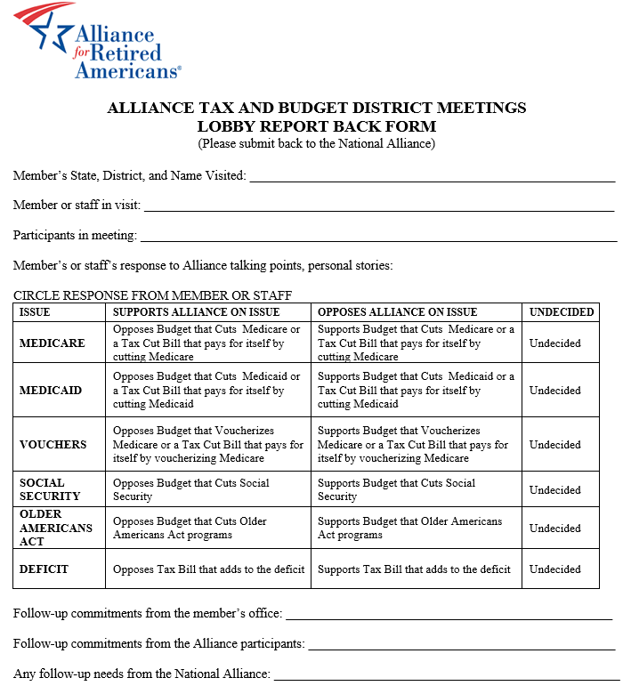
Lobby Visit Report Back Form
Action Hotline
Call Your Representatives!
866-828-4162
Notes:
BIG CORPORATIONS AND THE WEALTHY MUST PAY THEIR FAIR SHARE OF TAXES.
• Our rigged and broken tax system lets big corporations and the wealthy avoid paying their fair share of taxes, sticking the rest of us with the tab.
• Tax reform must not cut taxes for big corporations or the wealthy.
• On the contrary, tax reform should restore taxes on the wealthiest estates and tax the income of investors as much as the income of working people.
• Tax reform must make our tax system more progressive than it is now.
• Big corporations and the wealthy must pay more in taxes than they pay now, so we can build an economy that works for all of us.
2.TAX REFORM MUST RAISE SIGNIFICANTLY MORE REVENUE.
• Tax reform must raise enough additional revenue over the long term to create good jobs and make the public investment we need in education, infrastructure, and meeting the needs of children, families, seniors and communities.
• Any tax reform that reduces revenues in the short term or the long term is unacceptable.
• Cost estimates must be honest and not rely on gimmicks that hide the true long-term cost of tax cuts.
3.TAX REFORM MUST ELIMINATE THE TAX INCENTIVE FOR CORPORATIONS TO SHIFT JOBS AND PROFITS OFFSHORE.
• Taxing offshore profits less than domestic profits creates an incentive for corporations to shift jobs and profits offshore, while giving global corporations a competitive advantage over domestic corporations.
• Tax reform must eliminate the tax incentive for corporations to shift jobs and profits offshore, which would raise nearly $1 trillion over 10 years.
• A “territorial” system that further reduces taxes on offshore profits would increase the tax incentive for global corporations to shift jobs and profits offshore.
• Tax reform must encourage investment in domestic manufacturing, production and employment to ensure a robust manufacturing sector.
4. GLOBAL CORPORATIONS MUST PAY WHAT THEY OWE ON PAST PROFITS HELD OFFSHORE.
• Global corporations owe an estimated $700 billion in taxes on the $2.6 trillion in past profits they are holding offshore.
• Tax reform should use these one-time-only tax revenues to increase smart public investment in infrastructure rather than cut corporate tax rates permanently.
• The higher the tax rate on these accumulated offshore earnings, the more funding will be available for public investment in infrastructure.

Slide 14
Questions?
We’re Here to Help!
If you have any questions,
ask your local organizer and contact the Alliance
Brendan Kelly
Field Director
bkelly@retiredamericans.org
202.637.5272
Maureen Dunn
Field Manager
mdunn@retiredamericans.org
202.637.5351
Michelle Campbell
Department Administrator
mcampbell@retiredamericans.org
202.637.5361

